Slide 1

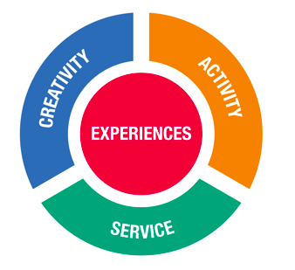
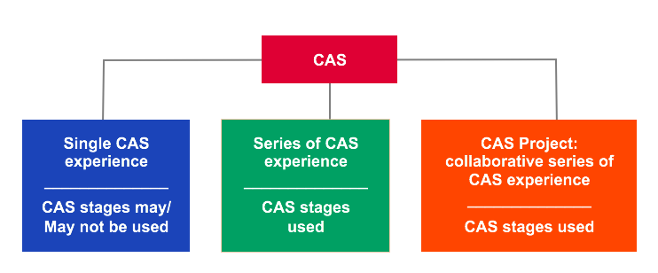
CAS Projects

Slide 2
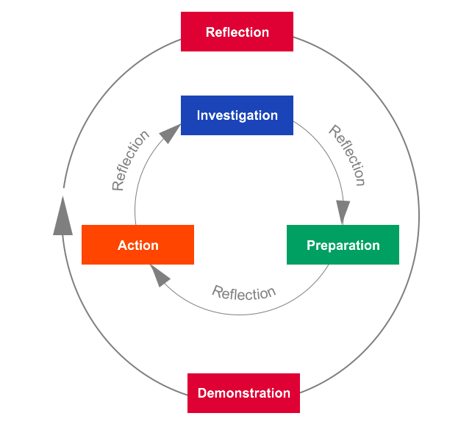
CAS Projects
1. A CAS experience where you must show you work towards achieving at least 3 Learning Objectives ( Initiative & Planning, Collaborative Skills and Strength & Growth)
2. Your project has to be longer than one month.
3. Although it can have one strand (Creativity, Action or Service) preferably you will have at least two of these.
4. Show evidence of using CAS Stages.

Slide 3
Using the Stages in Service
1. Investigation: Social analysis of a selected issue, with identification and confirmation of a community need, often with the designated community partner.
2. Preparation: Students design a service plan appropriate to the identified need, with clarification of roles and responsibilities, resource requirements, and timelines to successfully implement the plan. Any community partners are likely to be consulted.
3. Action: Students implement the plan through direct service, indirect service, advocacy, or research

Slide 4

Using the Stages in Service
4. Reflection: Feelings and actions applied to the context of self, community and the world. With service learning, reflection often occurs with greater frequency as students identify significant moments generated by new situations and insights.
5. Demonstration: make explicit what and how you learned and what you have accomplished
Use Managebac

Slide 5
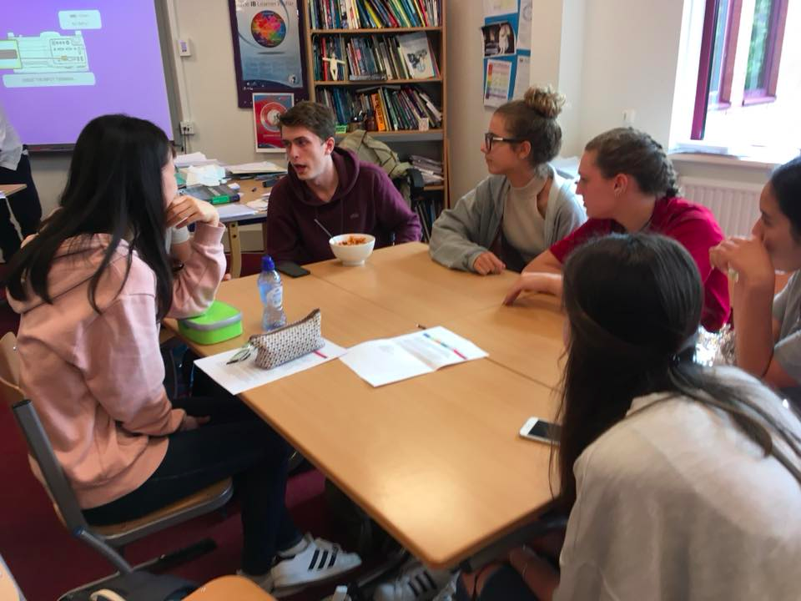
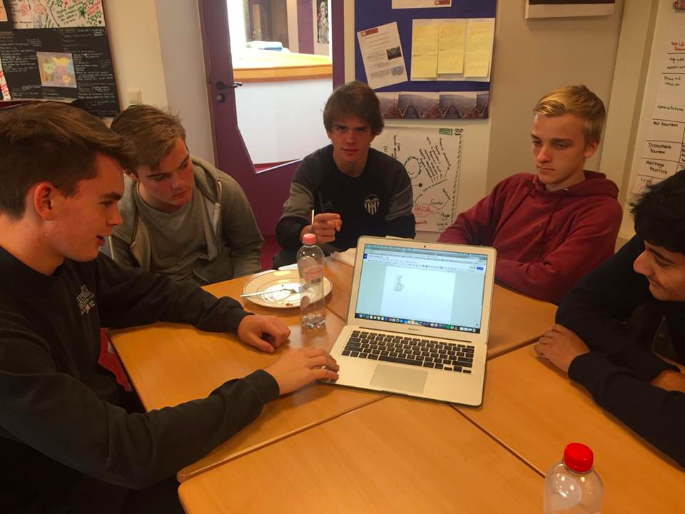
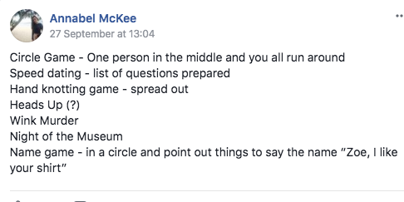

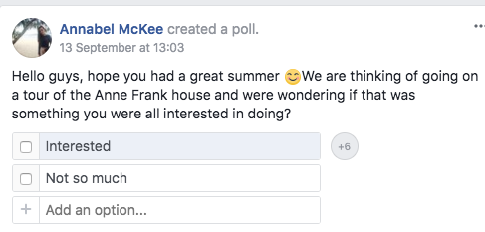
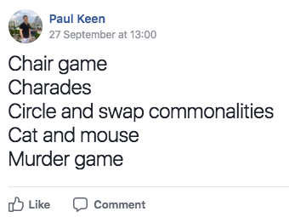

Slide 6
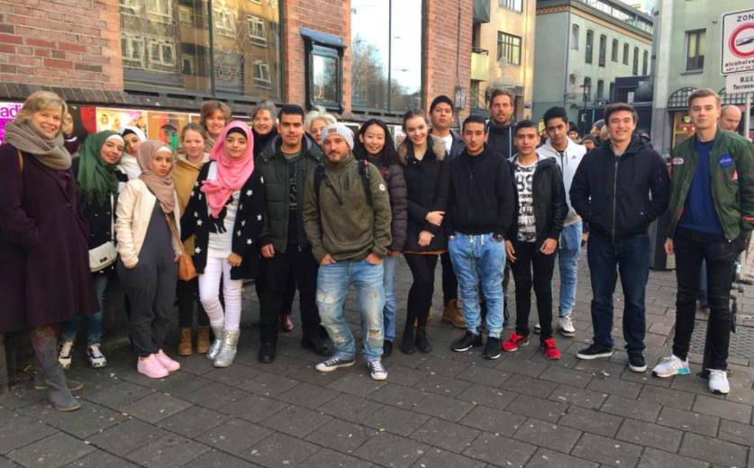
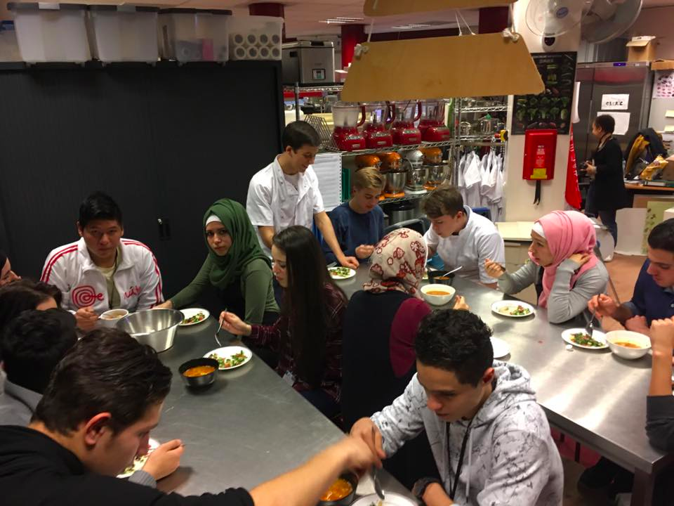
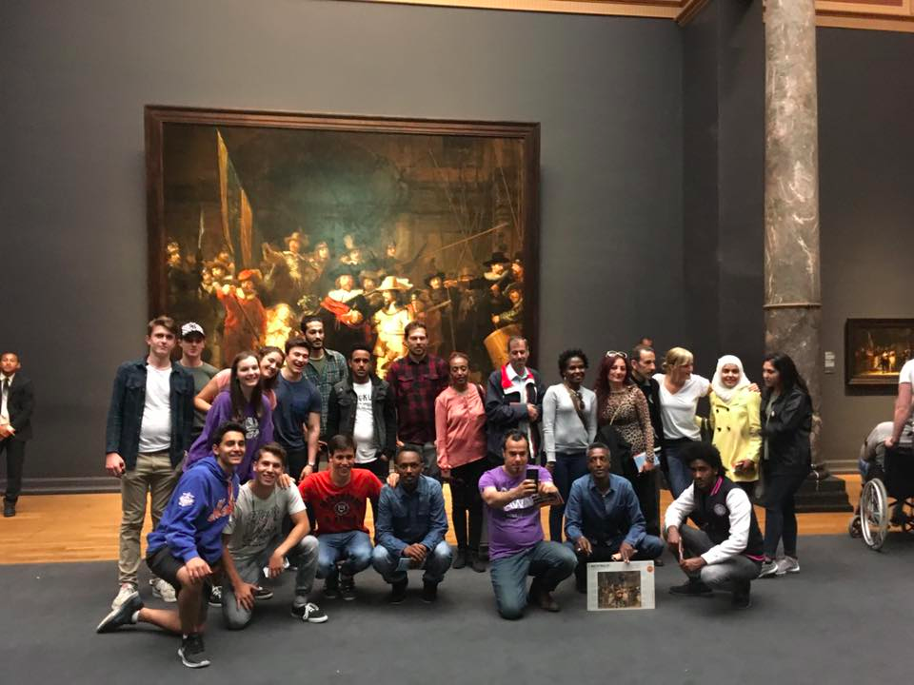

Slide 7
